Slide 1
Introduction to PeanutBase
and call for community participation
Steven Cannon – Intro; accessing the genomes
Sudhansu Dash – Examples; MAS
Ethy Cannon – Contributing & integrating data
Interactive example by Vikas Belamkar (after IBP presentation)
http://peanutbase.org/community - bottom of web page
Notes:
Title side

Slide 2
Contributors to PeanutBase development
Iowa Statue University/PeanutBase
Julie Dickerson - lead PI
Sudhansu Dash - geneticist and computational biologist
(content developer and curatorial lead)
Ethy Cannon - bioinformatics engineer
Deepak Bitragunta - student programmer
USDA-ARS at Ames, IA
Steven Cannon - lead
Nathan Weeks - IT specialist and computational biologist
Scott Kalberer - curator
Jugpreet Singh - postdoc
Wei Huang - genome browser
Longhui Ren - gene model analysis
Vikas Belamkar - use cases; biological guidance
National Center for Genomic Resources/
Andrew Farmer – lead, Legume Information System
Alex Rice (alumnus) - phylogenetic tree viewer
Pooja E. Umale - database loading, scripting
Hrishikesh A. Lokhande - web development
Alan Cleary - web development, database loading, scripting

Slide 3
Why Iowa??

Slide 4
Why Iowa??
USDA-ARS projects: SoyBase,
Legume Information System

Slide 5
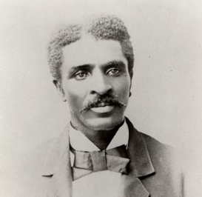
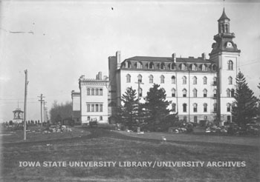
Why Iowa??
USDA-ARS projects: SoyBase,
Legume Information System
Also this legacy: George Washington Carver was trained at Iowa State College, 1891-1896: first black student and first black faculty

Slide 6
About PeanutBase:
Funded by The Peanut Foundation
In-kind contributions from ARS:
Legume Information System (http://legumeinfo.org),
SoyBase (http://soybase.org)
many people in the Peanut Genomics Initiative (PGI)
Objective is to serve the peanut research community, and help make data from the PGI accessible and useful
We really want to make the resource as useful as possible; will need your expertise, help, and feedback
Next: A quick tour of a few features:
Notes:
Overview and whom it is meant for: 2 slides

Slide 7
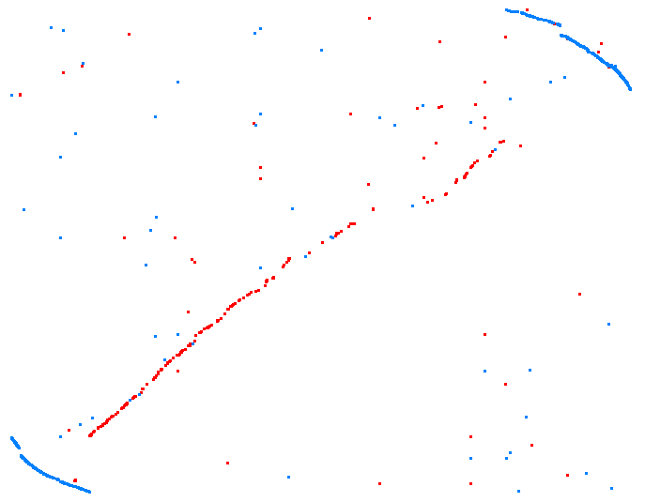
The A. duranensis and A. ipaensis genomes are available ...
and big: 1.1 and 1.4 billion bases; ~100 million / chrom.
Ara. duranensis A01
Ara. ipaensis B01

Slide 8
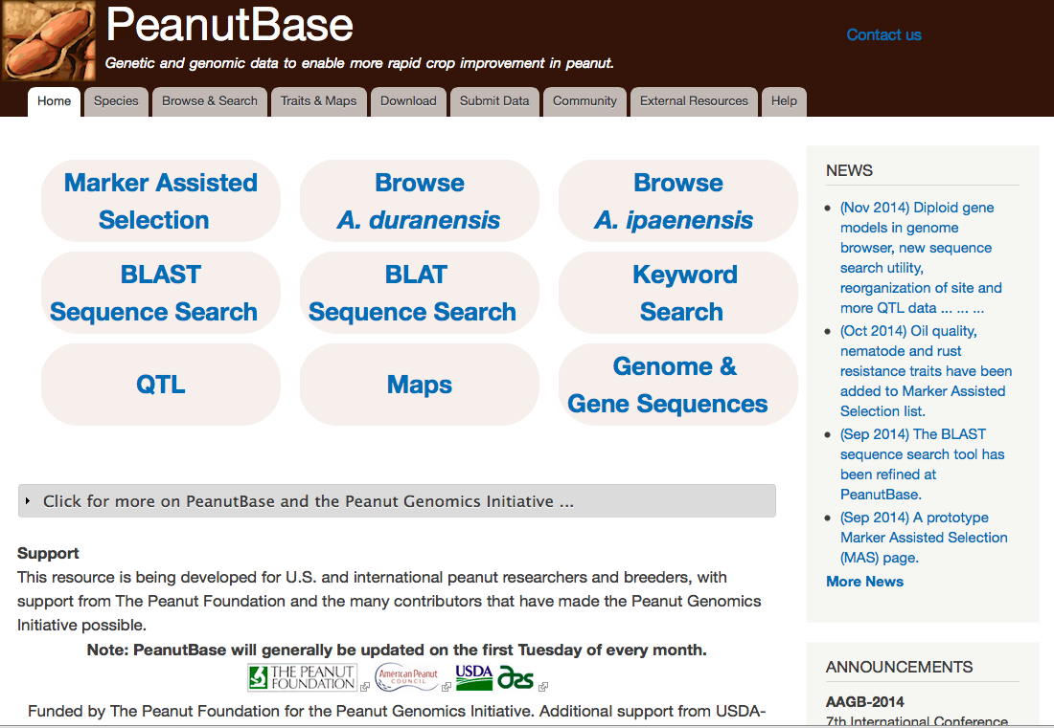
Accessing the genomes and genes:

Slide 9
Accessing the genomes and genes. Example: BLAT

Slide 10
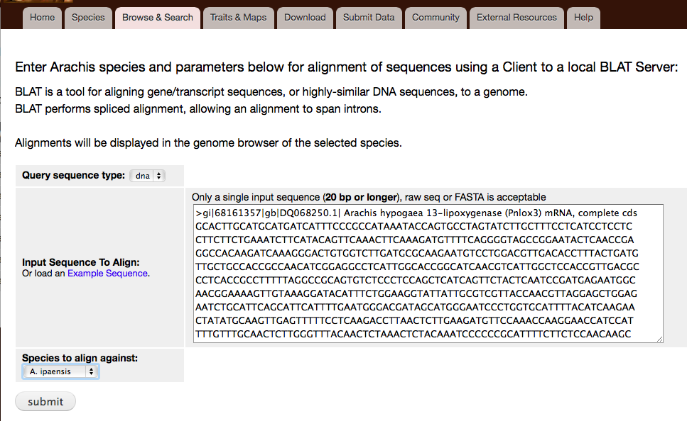
Accessing the genomes and genes. Example: BLAT

Slide 11
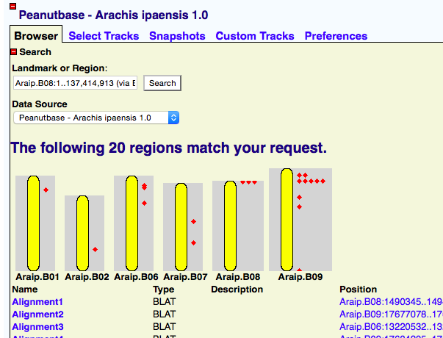
… The BLAT hits on A. ipaensis: genome overview

Slide 12
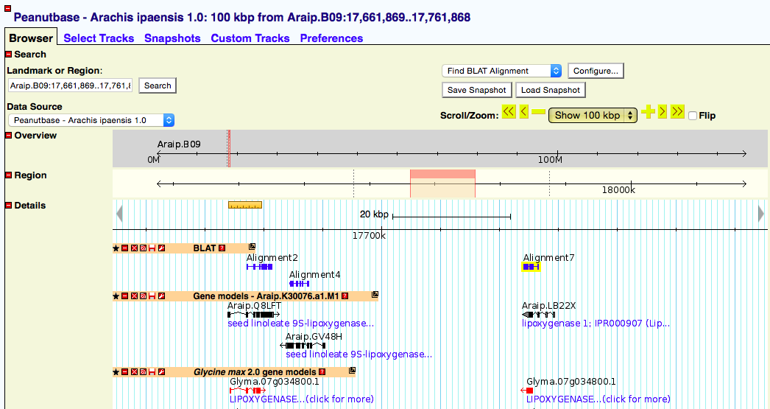
… takes us to the A. ipaensis browser (GBrowse)
Select tracks

Slide 13
… takes us to the A. ipaensis browser (GBrowse)
Learn about tracks (“?”), download, configure

Slide 14
… takes us to the A. ipaensis browser (GBrowse)
Navigate, zoom, slide

Slide 15
… takes us to the A. ipaensis browser (GBrowse)
Additional tools: download; search again
Peanut gene models
.M1 = Maker annotation 1
Soybean gene models: often provide clues

Slide 16
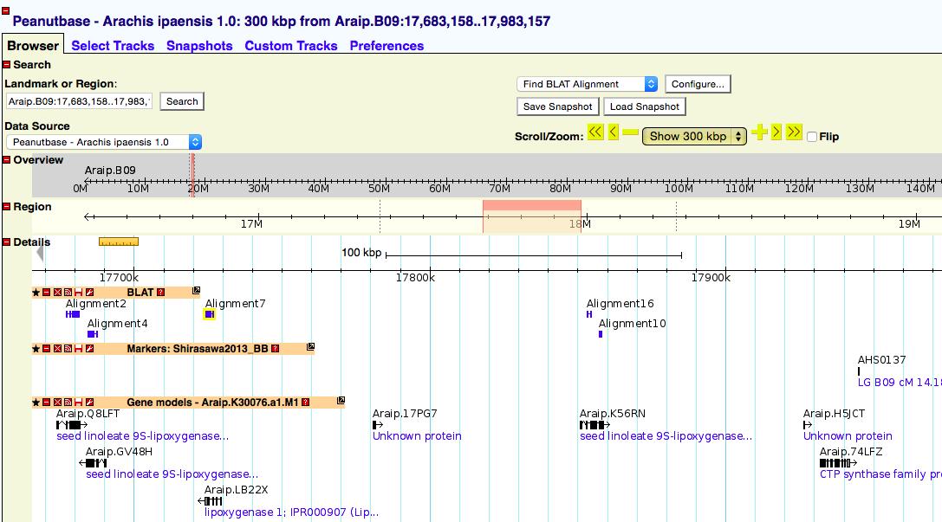
… takes us to the A. ipaensis browser (GBrowse)
A new track: markers
added a new
marker track

Slide 17
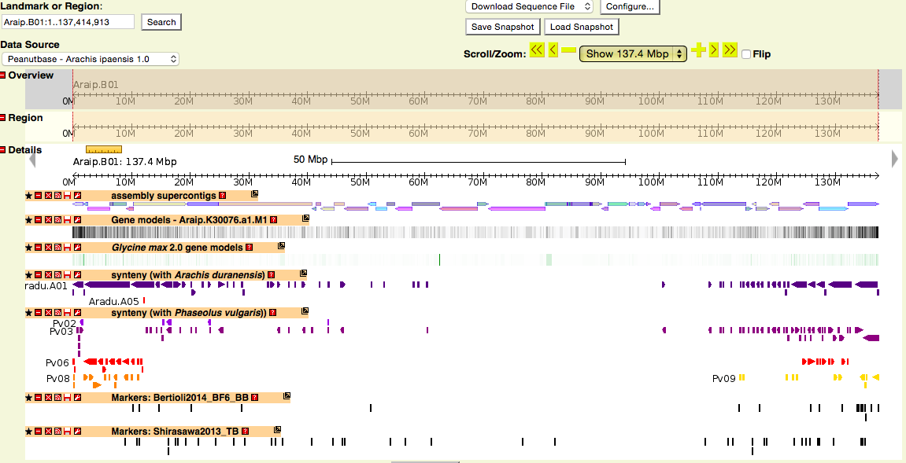
A full chromosome in the A. ipaensis browser
Scaffolds
Genes
Correspondences with …
A. duranensis
common bean
Markers

Slide 18
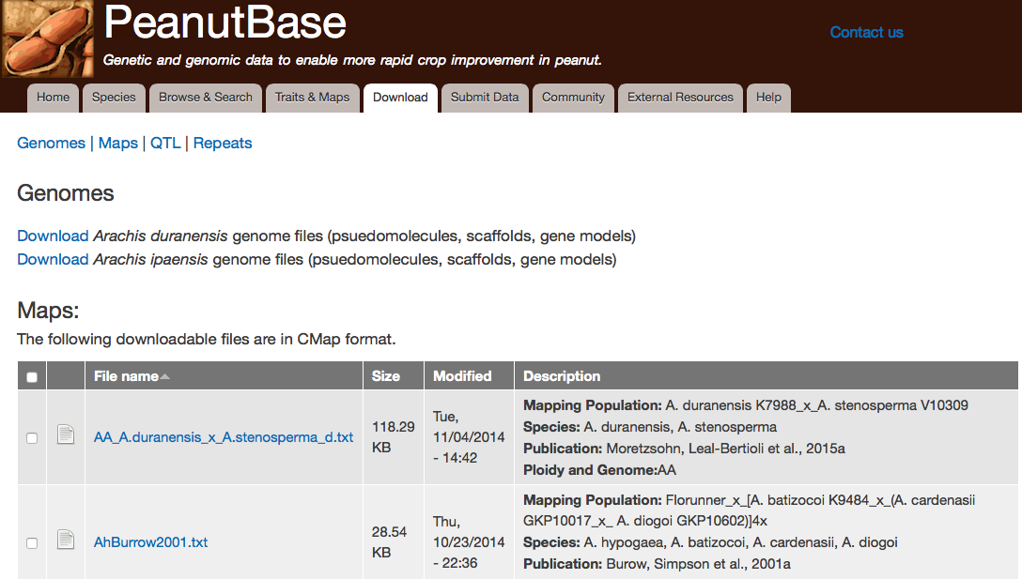
Or: download the full genomes or gene predictions

Slide 19
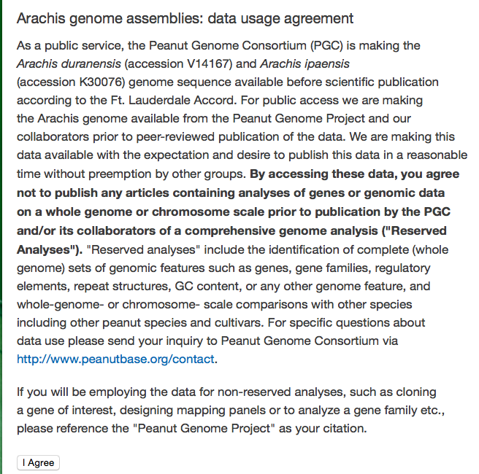
Or: download the full genomes or gene predictions
Basically: please use this data, but don’t scoop the PGC on major genome-scale analyses. Contact us if you have questions.

Slide 20
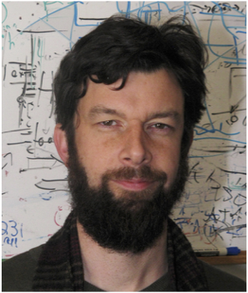
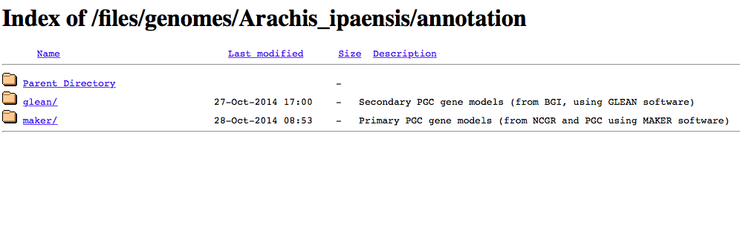
Or: download the full genomes or gene predictions
Andrew Farmer (NCGR)
BGI
NCGR

Slide 21
Some projects in the coming year:
Tetraploid genome assembly and annotation with the PGI
Helping handle RIL GBS analysis (Holbrook, Guo et al.)
Adding and further linking in markers and maps
Many more QTLs, markers for important traits - with you
Working towards integration with breeder tools in IBP
Notes:
Overview and whom it is meant for: 2 slides

Slide 22
PeanutBase is a community resource. We want to hear from you how we can meet your needs.
Services:
Curate *data (QTL, maps, markers, traits) from significant publications
Work with authors to prepare their data for inclusion at PeanutBase (before or after publication).
Deploy and develop modules for important types of data (e.g. QTL, maps, markers, traits)
Marker-assisted selection pages with help from experts in the community
Next:
Sudhansu: two examples, and some new features
Ethy: pulling everything into a common framework; how you can help

Slide 23
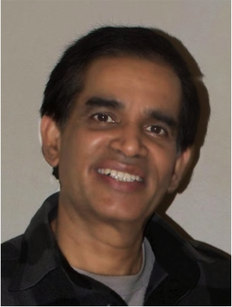
Sudhansu Dash – Lead curator
Geneticist & Computational Biologist

Slide 24
Seamless Integration: Traits, Maps, Markers, Genome, Genes, Orthologs, Annotations, etc.
What we are striving for:

Slide 25
Seamless Integration: Traits, Maps, Markers, Genome, Genes, Orthologs, Annotations, etc.
What we are striving for:
Genetic features should be well connected with sequence- based features

Slide 26
Examples
Start from a sequence
Start from a mapped trait
Using the Marker-Assisted Selection pages

Slide 27
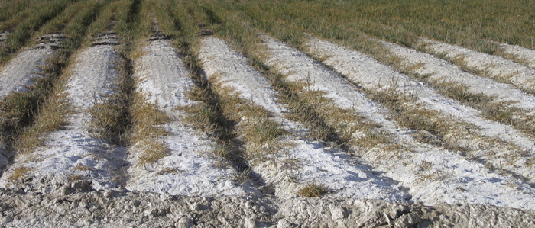
Example 1: Start from a sequence
You are interested in soil salinity and it is not well studied in peanut
Salinity affected land:
http://salinityforum2014.ucr.edu/

Slide 28
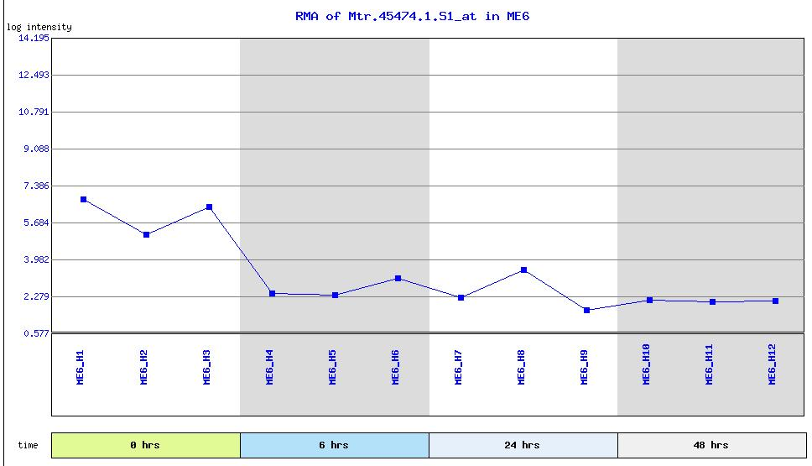
Example 1: Start from a sequence
Start: a sequence known in Medicago truncatula:
A candidate gene shows expression response in 6 hrs.
Salinity affected land:
http://salinityforum2014.ucr.edu/

Slide 29
Example 1: Start from a sequence
Start: a sequence known in Medicago truncatula:
A candidate gene shows expression response in 6 hrs.
>Mtr.45474.1.S1_at affx|TC99732 | Down in salt stress
ataacacaaacagtgcaacagcaacatcaactgcaacgactattactagtgcaccctcaa
gctcaacggtttcaagaattgttcttttacttttgagggtgttaacttttgtgtttcttc
tcattgctctcatagtcattgtcttaaccaaggaaactttagagacaagttttggtgaat
cggaaattaagttcaacgatatccatgcttttcgatacatgatctccacaatagtaattg
ggtttgcatacaaccttcttcaaatggcactttcaattttcaccgtggtctcaggaaatc
gtgtattaagtggtgatggaggctatatgtttgatttttttggtgacaagattatatcat
actttctactttccggttcagctgctggatttggtgcatcagaagatctacatagaatct
tcaaagcaggagaattgcctttaaactcattctttggaaaggctaatgcctcaactagcc
ttcttcttttaggatttctaactacagcaatagcttcaattttcacttcatttgctttgc
caagaagagctaaatagcattaattttcacttcatttgcttaaatgaaagctttgttgta
tgcacaaaatgatttattctctaat
Salinity affected land:
http://salinityforum2014.ucr.edu/

Slide 30
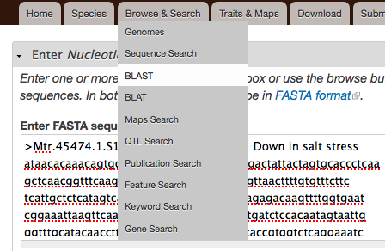
Example 1: Start from a sequence
BLAST sequence search with the Medicago sequence
>Mtr.45474.1.S1_at affx|TC99732 | Down in salt stress
ataacacaaacagtgcaacagcaacatcaactgcaacgactattactagtgcaccctcaa
gctcaacggtttcaagaattgttcttttacttttgagggtgttaacttttgtgtttcttc
tcattgctctcatagtcattgtcttaaccaaggaaactttagagacaagttttggtgaat
cggaaattaagttcaacgatatccatgcttttcgatacatgatctccacaatagtaattg
ggtttgcatacaaccttcttcaaatggcactttcaattttcaccgtggtctcaggaaatc
gtgtattaagtggtgatggaggctatatgtttgatttttttggtgacaagattatatcat
actttctactttccggttcagctgctggatttggtgcatcagaagatctacatagaatct
tcaaagcaggagaattgcctttaaactcattctttggaaaggctaatgcctcaactagcc
ttcttcttttaggatttctaactacagcaatagcttcaattttcacttcatttgctttgc
caagaagagctaaatagcattaattttcacttcatttgcttaaatgaaagctttgttgta
tgcacaaaatgatttattctctaat

Slide 31
Example 1: Start from a sequence
BLAST search result: A match in Chrom. A04
(in diploid A. duranensis)

Slide 32
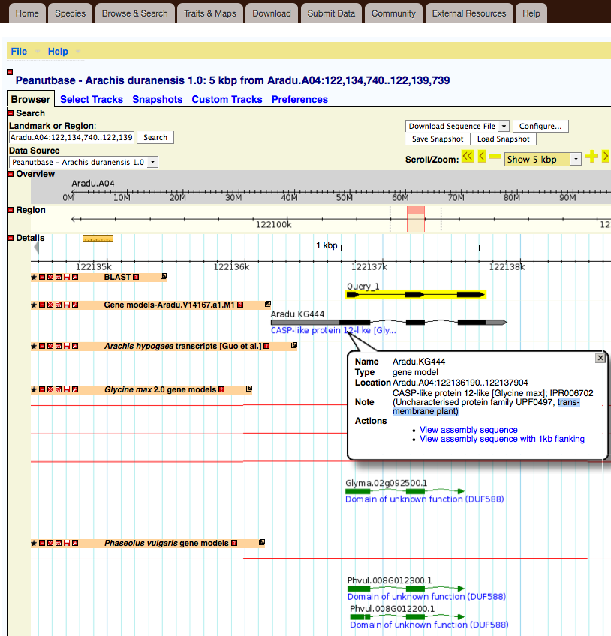
Example 1: ... Match found. Go to ...
BLAST search result: A match in Chrom. A04
... links to genome browser

Slide 33
Example 1: ... the genome browser
BLAST search result in Genome Browser track
Query is highlighted

Slide 34
Example 1: ... the genome browser
BLAST search result in Genome Browser track
Query is highlighted
Predicted gene (Aradu.KG444)

Slide 35
Example 1: ... the genome browser
BLAST search result in Genome Browser track
Query is highlighted
Predicted gene (Aradu.KG444)
Shows predicted functions (trans-membrane protein)

Slide 36
Example 1: ... the genome browser
BLAST search result in Genome Browser track
Query is highlighted
Predicted gene (Aradu.KG444)
Shows functional description
Matching genes in
Soybean and
common bean

Slide 37
Example 1: ... A candidate gene?
Predicted gene in peanut: Aradu.KG444 - A candidate for testing salinity response in peanut.

Slide 38
Example 1: ... Need more info …
Predicted gene in peanut: Aradu.KG444 - A candidate for testing salinity response in peanut.
Is it worth spending the money on this gene for salinity response trait?
Can PeanutBase help find more about this sequence in the plant world?

Slide 39
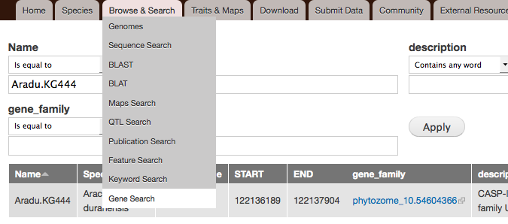
Example 1: ... Need more info …
Do a Gene Search (Aradu.KG444)
Links to our sister database, Legume Information System (LIS; LegumeInfo.org)
developed with Andrew Farmer’s group at NCGR

Slide 40
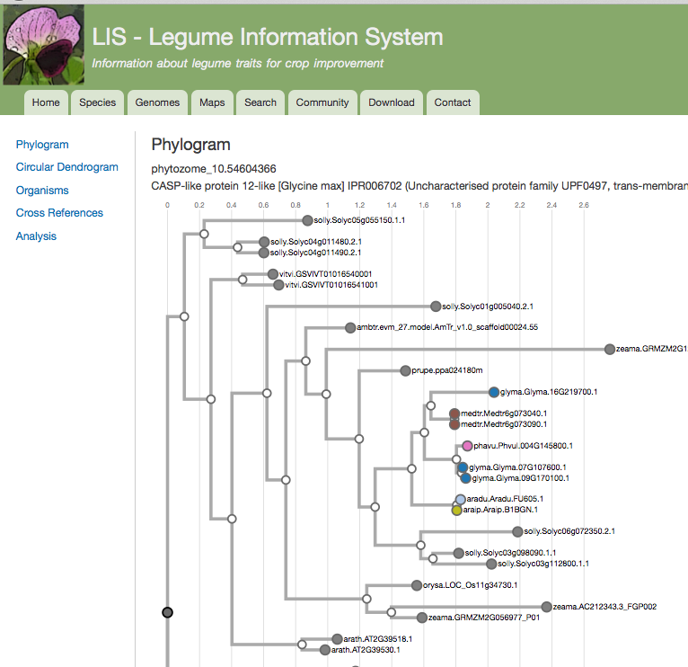
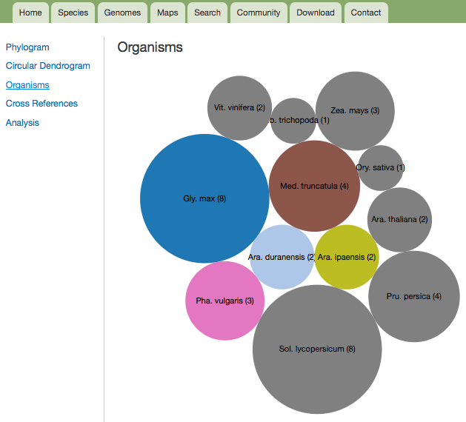
Example 1: ... about related genes ...
Do a Gene Search (Aradu.KG444)
Leads to many other resources using membership in a gene family
represented in 11 other species

Slide 41
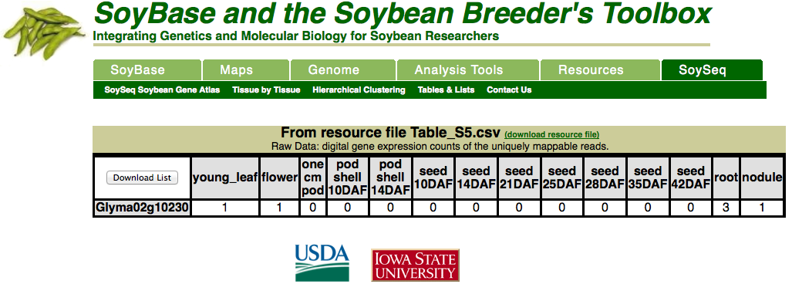
Example 1: ... e.g. soybean expression

Slide 42
Example 1: Summary
Starting from a Medicago sequence, identify candidate peanut genes.
BLAST search to find related genes in peanut
Explore the candidate gene using Genome Browser
Gene search to find related genes in other species
Get relevant information such as gene expression from other species
... to help you make an informed decision before you spend efforts and resources in peanut

Slide 43
Example 2: Start from a mapped trait

Slide 44
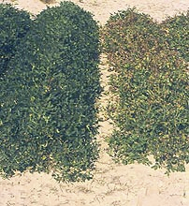
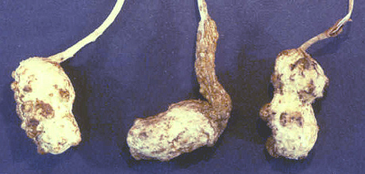
Example 2: Start from a mapped trait
Root-knot Nematode Resistance
Goal: find genetic and genomic region, and markers
http://www.plantmanagementnetwork.org/pub/php/management/rootknot/

Slide 45
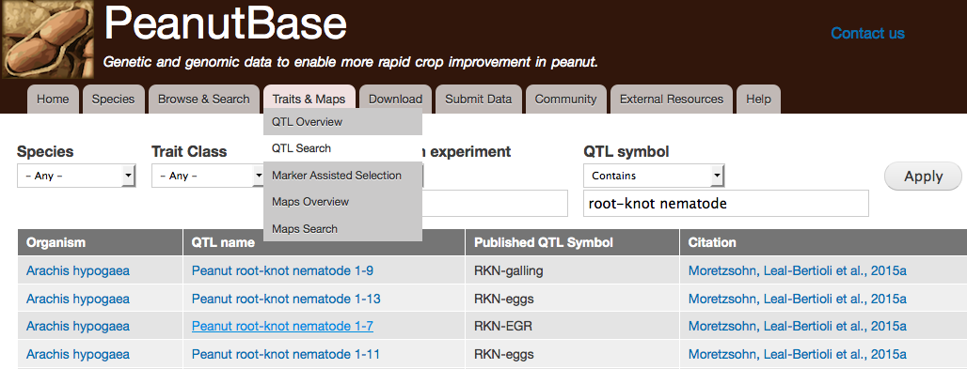
Example 2: Start from a mapped trait
Start with a QTL search

Slide 46
Example 2: (Contributed QTL data!!)
Start with a QTL search (Nematode QTL data contributed by Moretzsohn, Leal-Bertioli et al.)

Slide 47
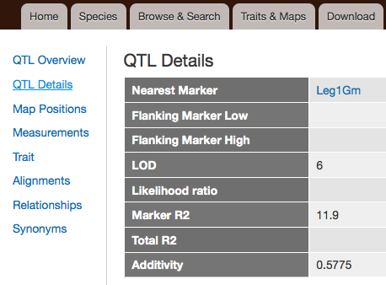
Example 2: QTL data integrated, searchable
Start with a QTL search
Check side tabs, e.g. for marker information

Slide 48
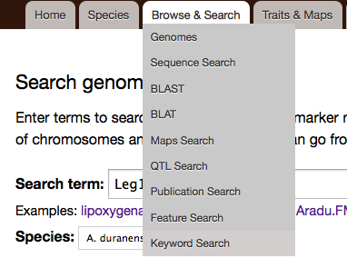
Example 2: ... gives us a linked marker
Start with a QTL search
Check side tabs, e.g. for marker information
... then use the marker in a keyword search

Slide 49
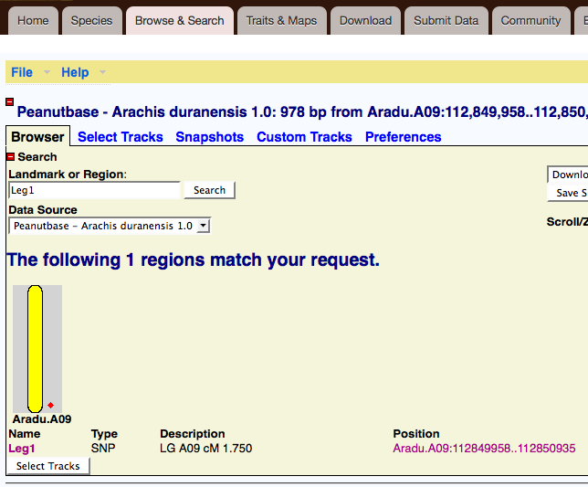
Example 2: From marker ... to genome
Start with a QTL search
Check side tabs, e.g. for marker information
... then use the marker in a keyword search
... to find the genomic region

Slide 50
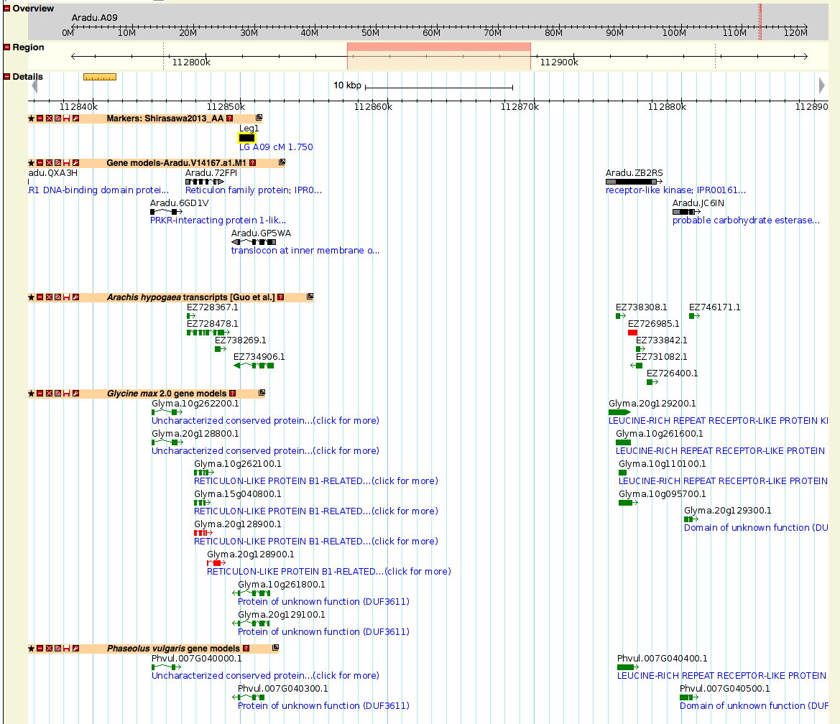
Example 2: From marker ... to genome
The marker’s genomic region on Chr A.09

Slide 51
Example 2: From marker ... to genome
The marker’s genomic region on Chr A.09
Remember: the genomic region may be large!

Slide 52
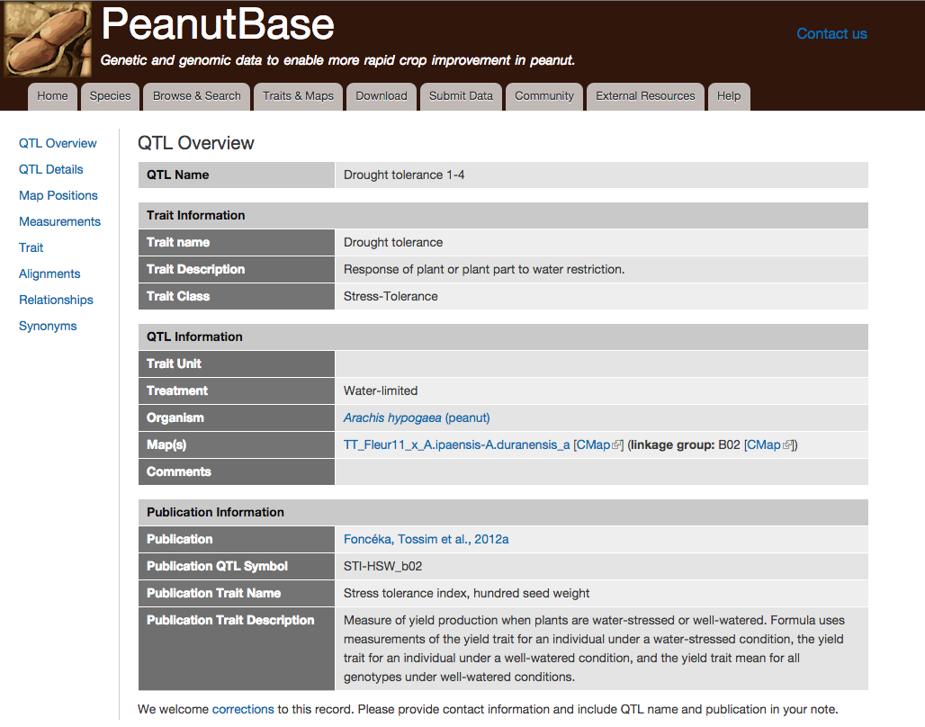
Example 2: From QTL ... to genetic map
Also from the QTL search, you can go to a QTL’s genetic map

Slide 53
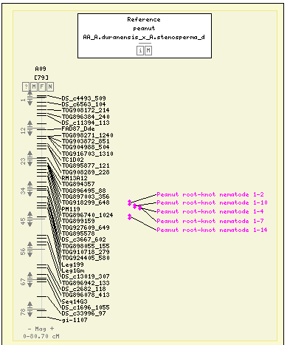
Example 2: From QTL ... to genetic map
The marker’s genetic region on Chr A.09
The genetic and genomic regions are both valuable; check both.
click on arrows to zoom and identify other markers

Slide 54
Example 2: Summary
Root-knot Nematode Resistance
Goal: find genetic and genomic region, and markers
We started from a trait (Root-knot Nematode Resistance) and explored the a genetic and genomic regions; found additional markers, and started to look for candidate genes (with caution, because QTL regions can span very large genomic regions)

Slide 55
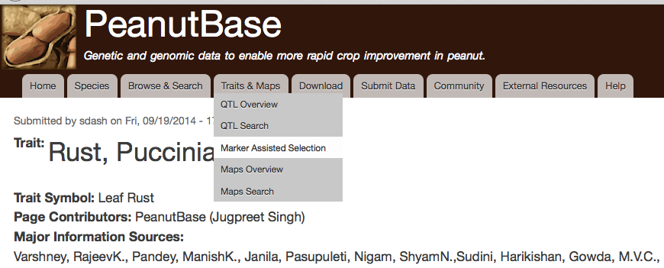
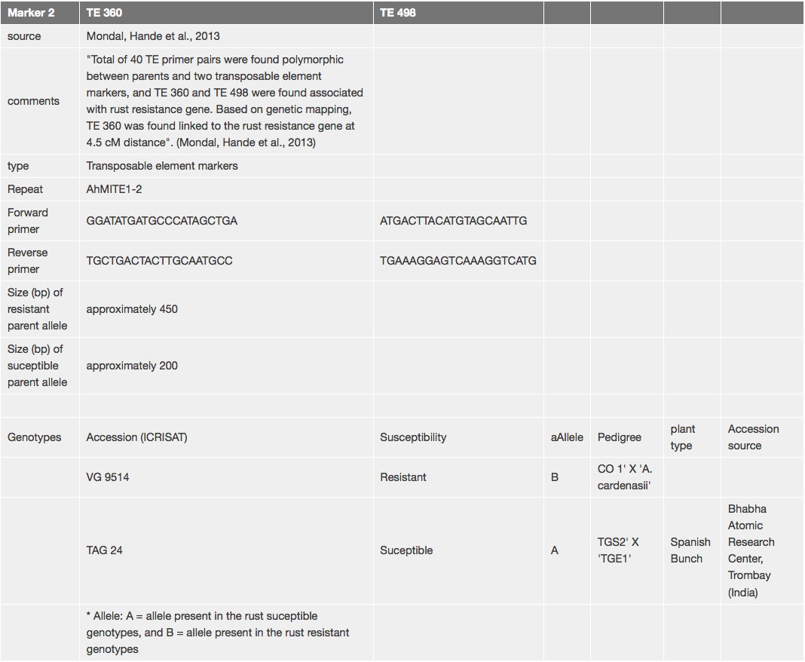
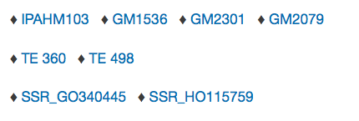
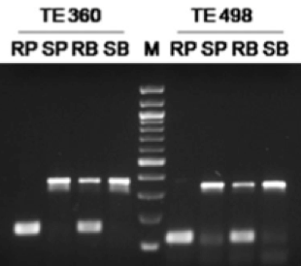
3. Marker Assisted Selection (MAS)
Markers for the trait
Informative for learners

Slide 56
3. Marker Assisted Selection (MAS)
Late leaf spot
Reaction to root-knot nematode
Seed oleic to linoleic acid ratio
Leaf rust

Slide 57
3. Marker Assisted Selection (MAS)
Late leaf spot
Reaction to root-knot nematode
Seed oleic to linoleic acid ratio
Leaf rust
We are especially looking for your contributions for more MAS pages

Slide 58
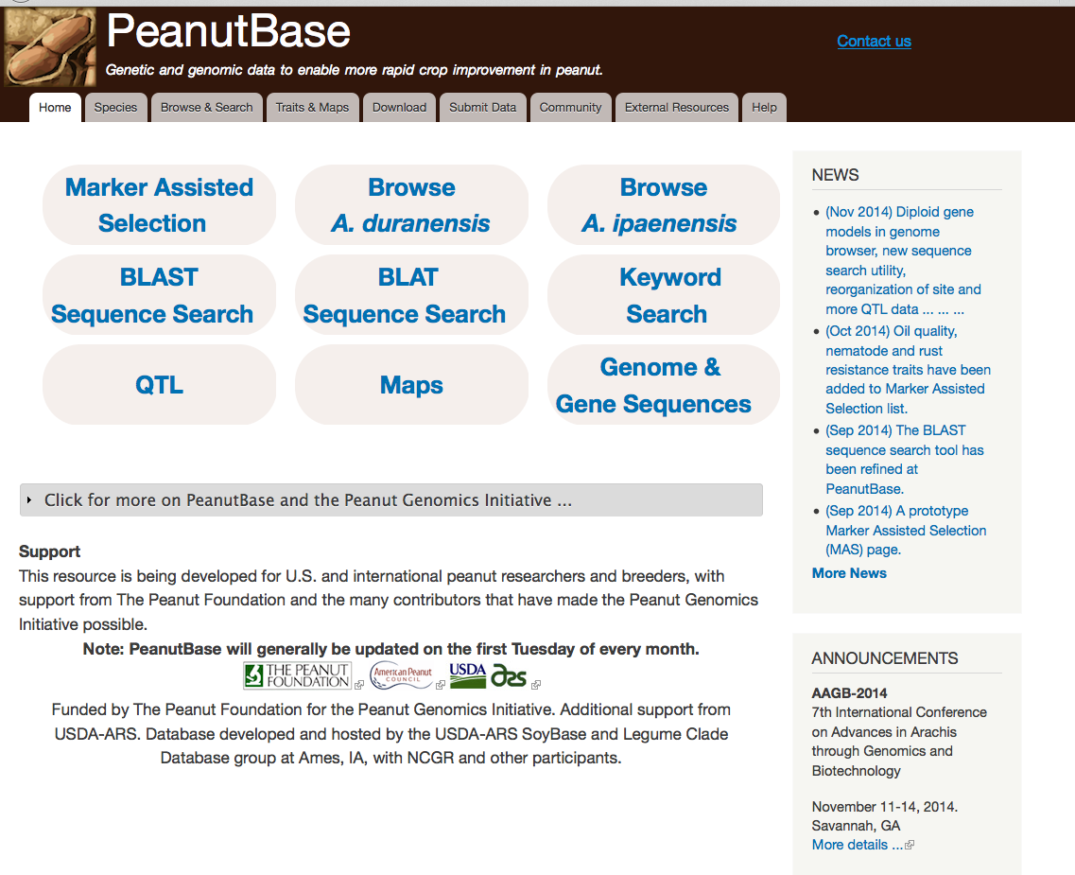

Slide 59
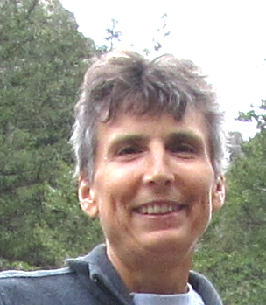
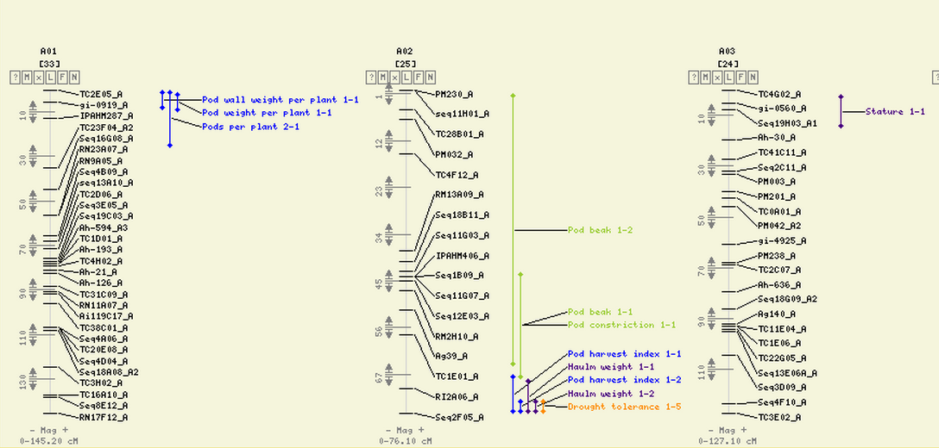
Ethy Cannon – Bioinformatics Engineer
• A brief overview of technical details,
• a summary of data currently served at PeanutBase,
• a focus on QTL data.

Slide 60
Infrastructure
Common database schema designed for biological data (Chado).
A modular website interface framework in common use for plant databases (Tripal).
Enables us to share data and development of website components with LegumeInfo, effectively increasing the size of both teams.
Enables us to collaborate with other plant databases that use the same framework.

Slide 61
Types of Data at PeanutBase
Reference genomes -- downloads and browsers
Gene models -- downloads, browsers, and record pages
Gene families and phylogenetic trees -- interactive view
Maps and markers -- download, search, interactive map view, and record pages
QTL -- download, search, interactive map view, and record pages
Publications curated at PeanutBase
Notes:
We’re a small team and have to make use of data and resources from other groups and databases where possible. Also working to get genomes into GenBank. Gene families to link to resources in other communities

Slide 62
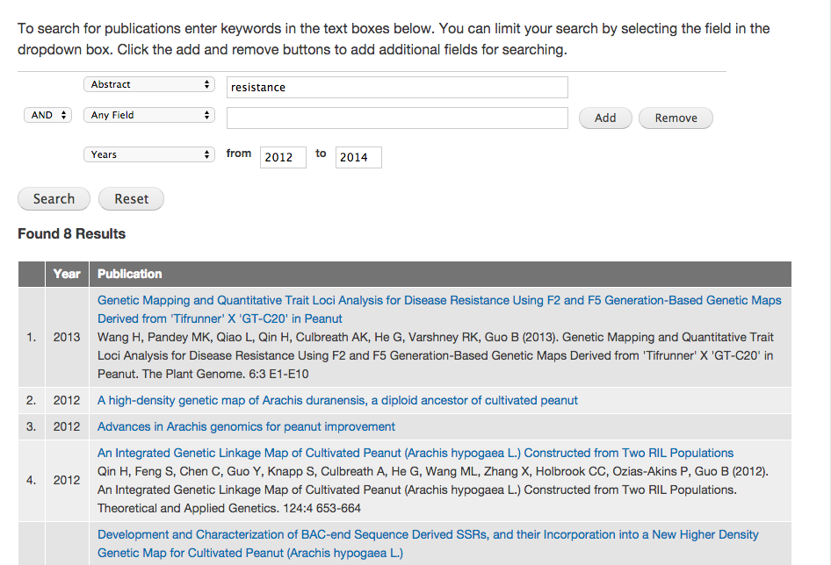
Tools and viewers at PeanutBase
Data searching and views
Publications
Maps
Genes

Slide 63
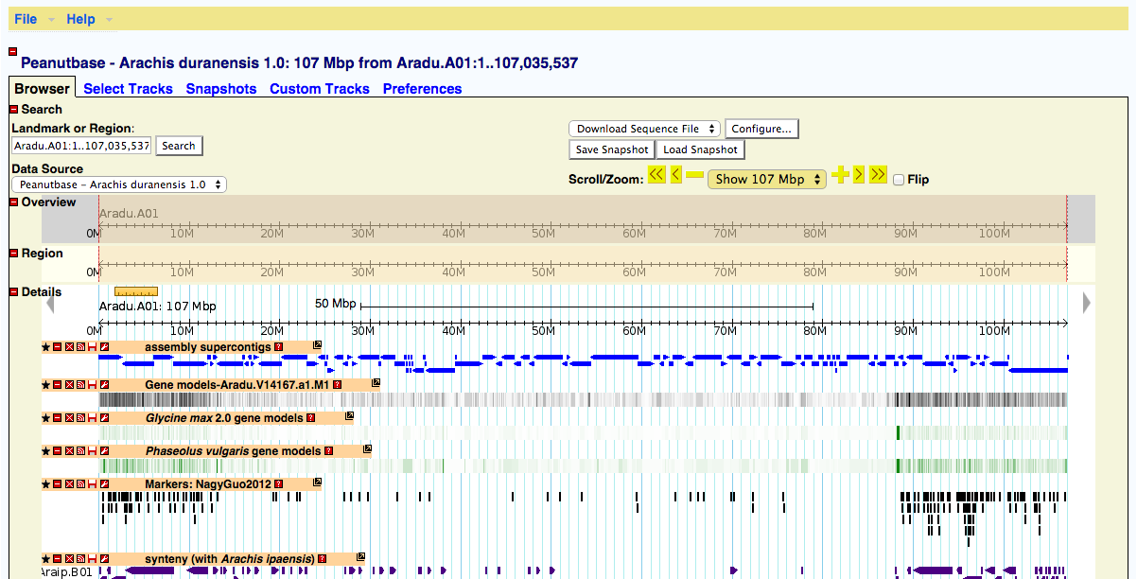
Tools and viewers at PeanutBase
Data searching and views
Genome browsers

Slide 64
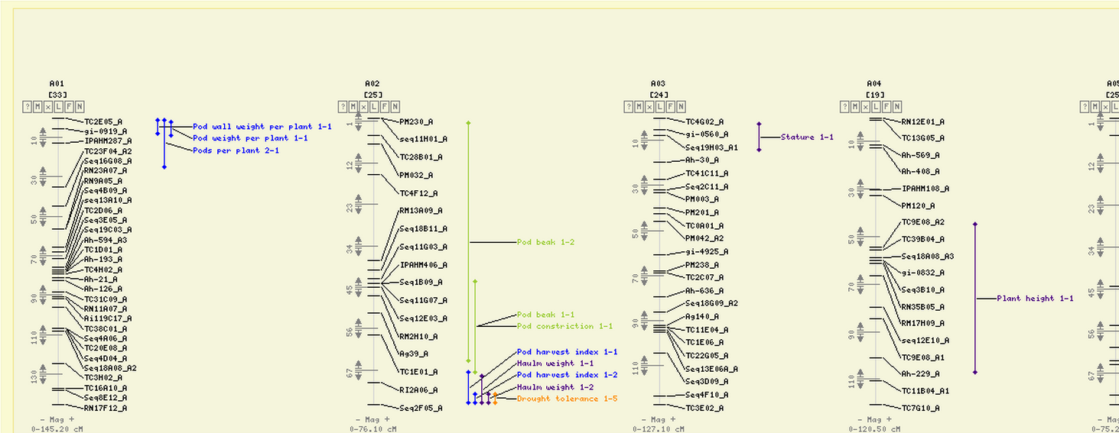
Tools and viewers at PeanutBase
Data searching and views
Genome browsers
Genetic map viewer (in collaboration with LIS)

Slide 65
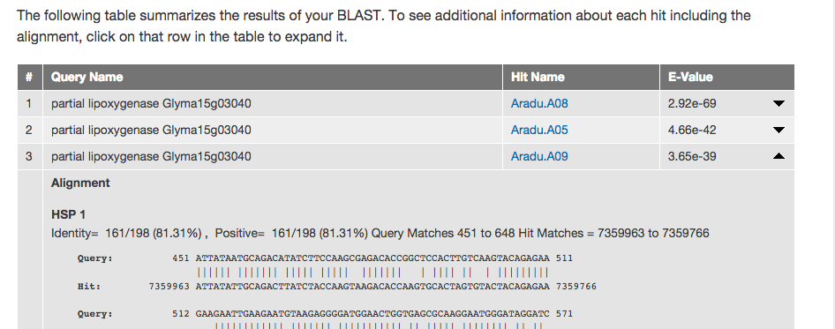
Tools and viewers at PeanutBase
Data searching and views
Genome browsers
Genetic map viewer (in collaboration with LIS)
BLAST and BLAT for sequence searching

Slide 66
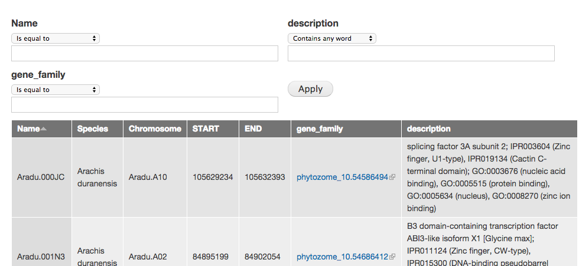
Tools and viewers at PeanutBase
Data searching and views
Genome browsers
Genetic map viewer (in collaboration with LIS)
BLAST and BLAT for sequence searching
Gene search (developed at LIS)

Slide 67
Tools and viewers at PeanutBase
Data searching and views
Genome browsers
Genetic map viewer (in collaboration with LIS)
BLAST and BLAT for sequence searching
Gene search (developed at LIS)
Phylogenetic tree viewer (at LIS / LegumeInfo.org)

Slide 68
Tools and viewers at PeanutBase
Data searching and views
Genome browsers
Genetic map viewer (in collaboration with LIS)
BLAST and BLAT for sequence searching
Gene search (developed at LIS)
Phylogenetic tree viewer (at LIS / LegumeInfo.org)
QTL (in prototype status)
Will focus on the QTL module.

Slide 69
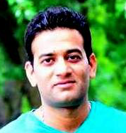
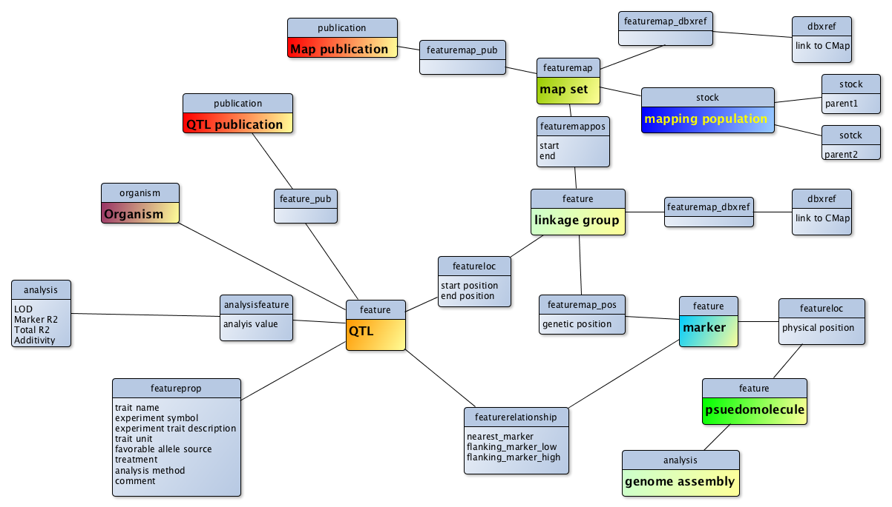
QTL data is complex and highly interconnected. We are trying to integrate across many data types and studies, and make it all more accessible.
Jugpreet Singh – Postdoc
Scott Kalberer – Curator
Notes:
Connections to other data types

Slide 70
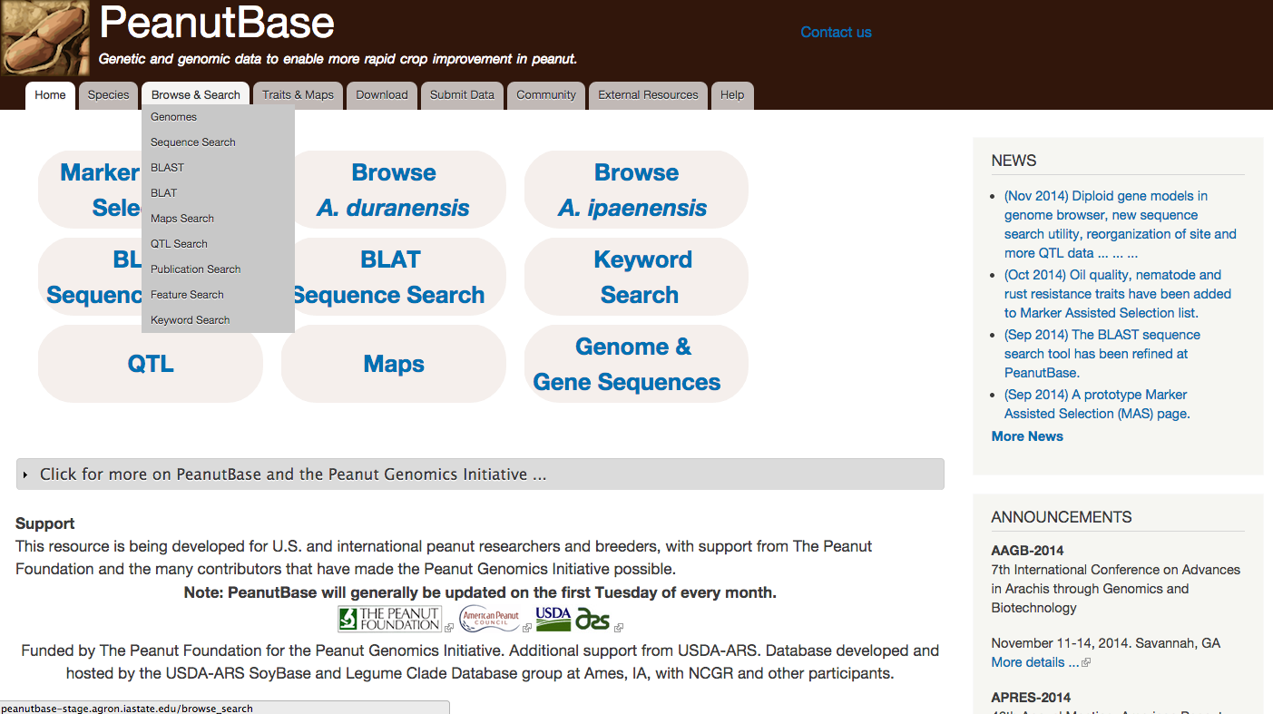
Finding the QTL data

Slide 71
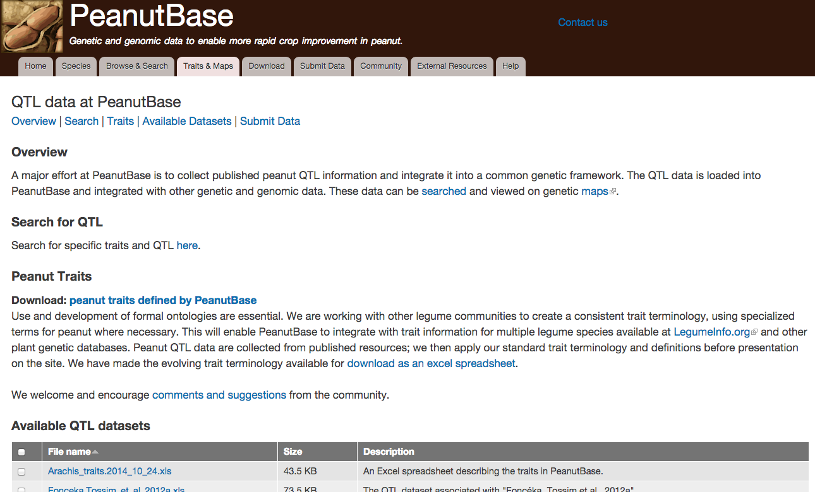
QTL overview page

Slide 72
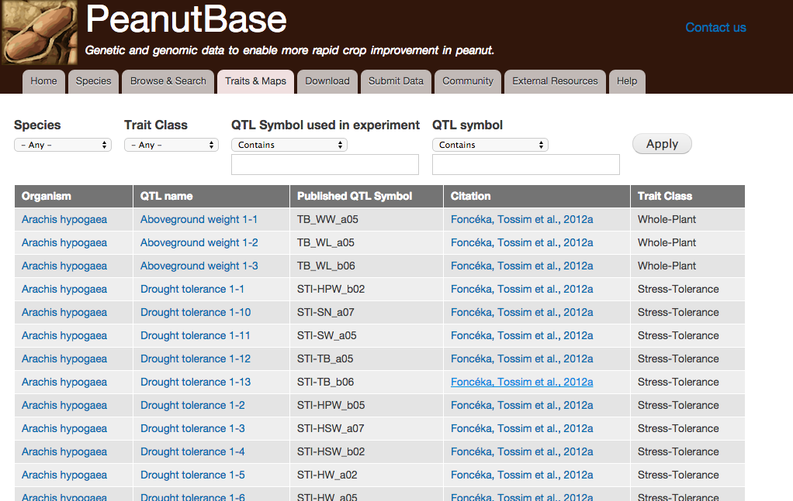
QTL Search Page
NOTE: QTL views are under development and will change.
Notes:
Read name of QTL

Slide 73
QTL record page - overview section

Slide 74
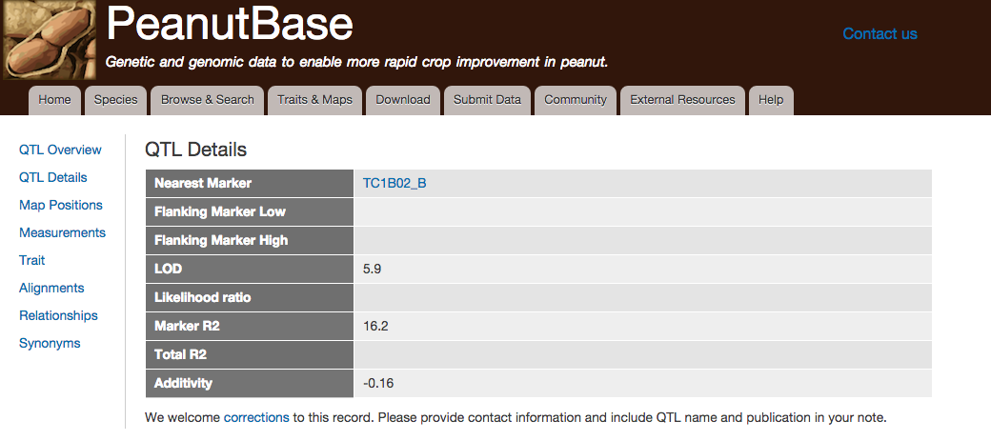
QTL record page - details section

Slide 75
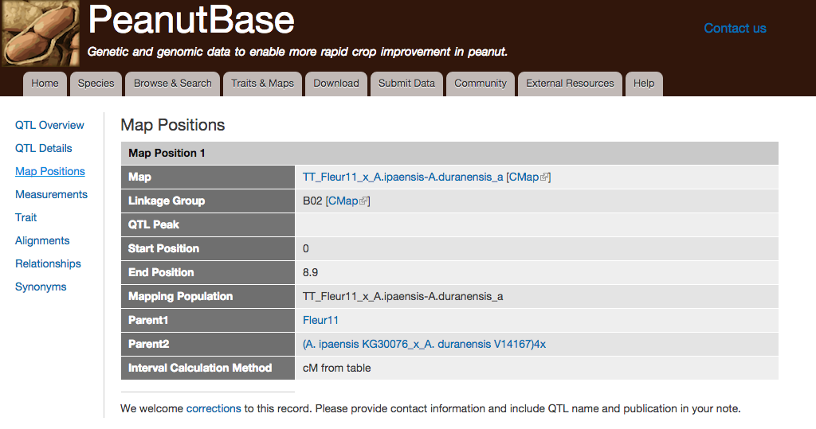
QTL record page - map positions
Notes:
Placing QTL on consenus maps so that QTL from multiple studies can be compared.

Slide 76
Data submissions from researchers
We want your data and have created a simplified spreadsheet template for researchers!

Slide 77
Data submissions from researchers
Map description worksheet

Slide 78
Data submissions from researchers
Map markers worksheet

Slide 79
Data submissions from researchers
QTL traits worksheet - required if QTL dataset

Slide 80
Data submissions from researchers
Parent traits worksheet

Slide 81
Please contact us to report bugs or errors, request datasets or new features, or to deposit public data.
Notes:
Report bugs, request features and datasets, give us your data.

Slide 82
Later OR on your own: Exercises / examples, with solutions at PeanutBase Community page (bottom)
Notes:
Report bugs, request features and datasets, give us your data.

